Slide 1


We are: Group 5
Presenting to
Presentation on
Information System Analysis of LafargeHolcim
3
2
Mr. Md. Iftekharul Amin
Assistant Professor
Institute of Business Administration
University Of Dhaka
Mahir Mahbub (Member) 0807
Atiq Ahammed (Captain) 0817
Khayrul Islam (Member) 0822
Sifat-E-Mahadi (Member) 0839
1

Slide 2

Outline
Background
Scope
Limitations
Methodology
Interviewee
SAP
ERP
Why SAP
Application Modules
Architecture
Memories
Reference

Slide 3




Background
Announced
Combined
7 April 2014
10 July 2015

Slide 4
Objective
Specific Objective
Broad
S
Analyze the SAP information system
Knowing its methodology
How the members and employees of the organization interact with it?
Why they think SAP can provide them better maintenance?
What is their recommendation for SAP to serve more?
B
Analyze the overall information system of LafargeHolcim

Slide 5

Scope
Interview
Paper Analysis

Slide 6

Limitations
Lack of time
Interview limitations
Lack of knowledge and experiences
Lack of questionnaires

Slide 7

Methodology
Meeting with manager of LafargeHolcim
Analysis LafargeHolcim and SAP information system papers

Slide 8
Interviewee
Md. Majharul Huda Lizan, Manager, logistics cost control LafargeHolcim Bangladesh Limited

Slide 9
SAP(System Application & Product)-Introduction
Leading Enterprise information and Management Package
There are n number of ERP software in the market, and SAP is the most used software in medium and large enterprises

Slide 10
SAP(System Application & Product)-Introduction
SAP is neatly integrated business software to process all functionalities of an organization’s different departments
SAP is a leader when it comes easy integration among all departments

Slide 11
ERP-(Enterprise Resource P)
SAP is neatly integrated business software to process all functionalities of a organization’s different departments
SAP is a leader when it come to easy integration among all departments

Slide 12
What makes SAP different?
Traditional computer information systems used by many businesses today have been develop to accomplish some specific task and provide reports and analysis of events that have already taken place.

Slide 13
What makes SAP different?
A typical company has many separate systems to manage different processes like production, sales and accounting.
Each of these systems has its own databases and rarely passes information to other systems in a timely manner.

Slide 14
What makes SAP different?
Sales can see when products can be delivered.
Production schedules are driven by sales.
The whole system is designed to be real-time and not historical.

Slide 15
SAP Application Module
SAP has several layers.
The Basis System is the heart of the data operations and should be not evident to higher level or managerial users.
Other customizing and implementation tools exist also.

Slide 16
SAP Application Module
• The heart of the system from a manager's viewpoint are the application modules.
• These modules may not all be implemented in a typical company but they are all related and are listed below:

Slide 17
SAP Application Module
Financial Accounting
Financial Supply Chain Management.
Controlling.
Material Management.
Sales and Distribution.
Logistic Execution.
Production Planning.
Quality Management.
Plant Maintenance.
Project system.

Slide 18
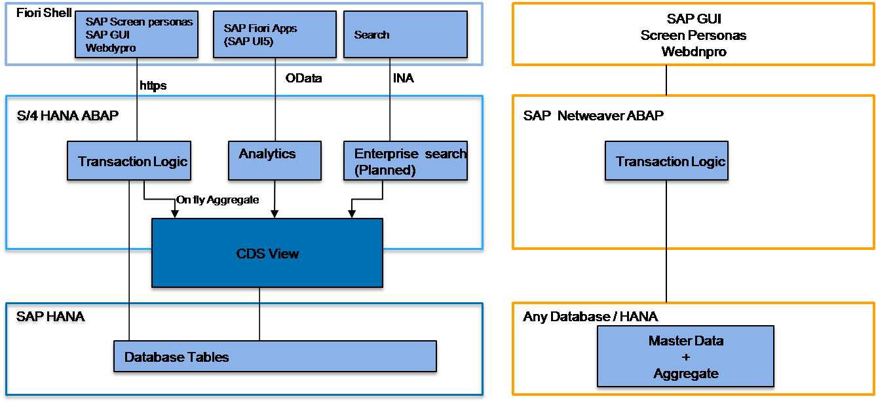
SAP Server Client Architecture

Slide 19
References
20 April 2018. [Online]. Available: https://searchsap.techtarget.com/definition/SAP-FICO-SAP-Finance-and-SAP-Controlling.
20 April 2018. [Online]. Available: https://www.sap.com/corporate/en/vision-purpose.html.

Slide 20

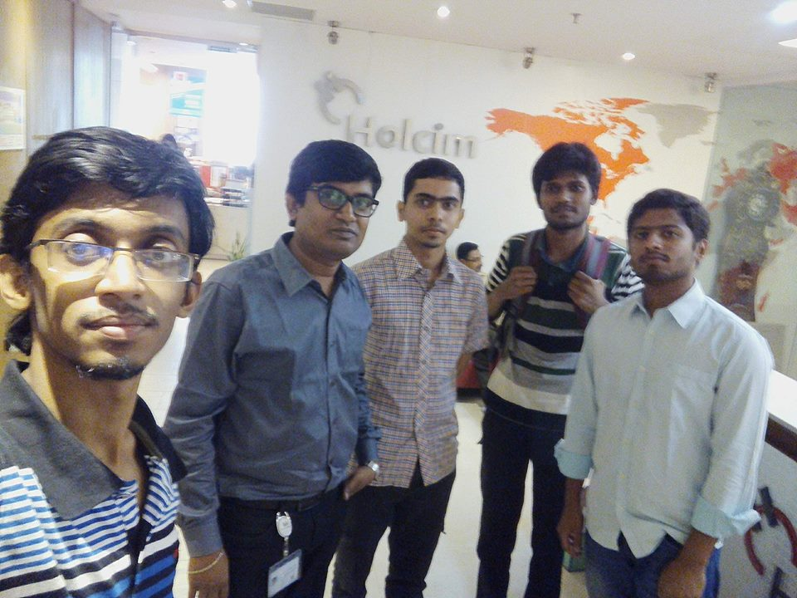
Memories

Slide 21


Any Question

Slide 22


